Slide 1
Chapter 1
Database Systems
Database Systems:
Design, Implementation, and Management, Sixth Edition, Rob and Coronel

Slide 2
In this chapter, you will learn:
The difference between data and information
What a database is, about different types of databases, and why they are valuable assets for decision making
Why database design is important
How modern databases evolved from files and file systems

Slide 3
In this chapter, you will learn:
About flaws in file system data management
How a database system differs from a file system, and how a DBMS functions within the database system

Slide 4
Data vs. Information
Data:
  Raw facts; building blocks of information
  Unprocessed information
Information:
  Data processed to reveal meaning
Accurate, relevant, and timely information is key to good decision making
Good decision making is key to survival in global environment

Slide 5
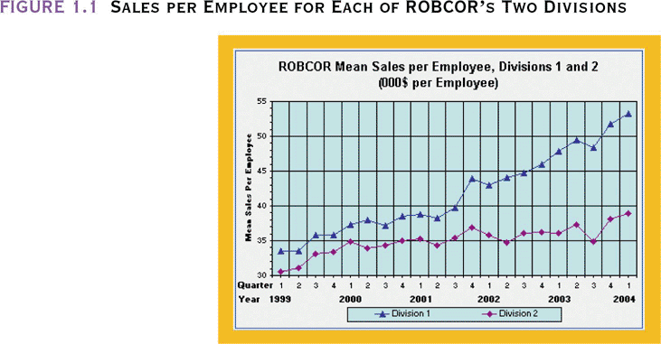
Sales per Employee for Each of ROBCOR’s Two Divisions

Slide 6
Introducing the Database and the DBMS
Database—shared, integrated computer structure that houses:
  End user data (raw facts)
  Metadata (data about data)

Slide 7
Introducing the Database and the DBMS (continued)
DBMS (database management system):
  Collection of programs that manages database structure and controls access to data
  Possible to share data among multiple applications or users
  Makes data management more efficient and effective

Slide 8
DBMS Makes Data Management More Efficient and Effective
End users have better access to more and better-managed data
  Promotes integrated view of organization’s operations
  Probability of data inconsistency is greatly reduced
  Possible to produce quick answers to ad hoc queries

Slide 9
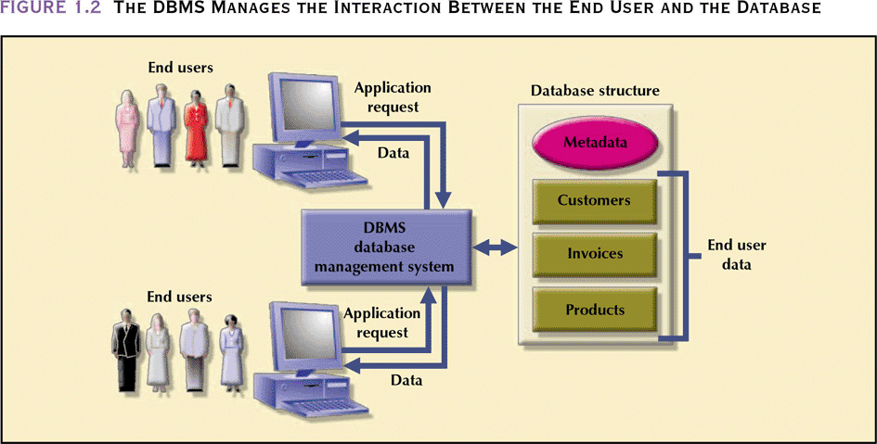
The DBMS Manages the Interaction Between the End User and the Database

Slide 10
Types of Databases
Single-user:
  Supports only one user at a time
Desktop:
  Single-user database running on a personal computer
Multi-user:
  Supports multiple users at the same time

Slide 11
Types of Databases (continued)
Workgroup:
  Multi-user database that supports a small group of users or a single department
Enterprise:
  Multi-user database that supports a large group of users or an entire organization

Slide 12
Location of Databases
Centralized:
  Supports data located at a single site
Distributed:
  Supports data distributed across several sites

Slide 13
Uses of Databases
Transactional (or production):
  Supports a company’s day-to-day operations
Data warehouse:
  Stores data used to generate information required to make tactical or strategic decisions
    Such decisions typically require “data massaging”
  Often used to store historical data
  Structure is quite different

Slide 14
Why Database Design is Important
Defines the database’s expected use
Different approach needed for different types of databases
Avoid redundant data (unnecessarily duplicated)
Poorly designed database generates errors → leads to bad decisions → can lead to failure of organization

Slide 15
Brief History of Information Systems -1
Early human records-clay tablets, hieroglyphics, cave paintings, paper records of family histories, treaties, inventories, and so on
Hollerith used punched cards in 1890 US census
Punched paper tape introduced in 1940s
Magnetic tape introduced about 1950-used in UNIVAC I
Cards, paper tape, magnetic tape are sequential access devices
Used in sequential processing applications such as payroll
Batch processing uses master file and transaction file as input; produces new master file as output

Slide 16
Brief History of Information Systems
Sequential Processing
Payroll Master File
Paychecks and stubs
Payroll Program
Payroll report
Transaction file with this week’s new payroll data
New Payroll Master File

Slide 17
Brief History of Information Systems - 2
Magnetic disk introduced in 1950s - direct access device
Programming languages COBOL and PL/1 developed in 1960s
Early database models developed
Hierarchical model
  IBM IMS developed for Apollo moon landing project
  IMS product released in 1968
  Most popular pre-relational DBMS
  SABRE airline reservation system used IMS
Network model
  GE IDS developed by Charles Bachman in early 1960s
  CODASYL DBTG proposed standards published in 1971
  ANSI rejected proposal
  New standards published in 1973, 1978, 1981 and 1984
  Provided standard terminology, notion of layered database architecture

Slide 18
Brief History of Information Systems-3
Relational model
  Proposed by E.F. Codd in 1970 paper, "A Relational Model of Data for Large Shared Data Banks"
  Strong theoretical foundation
  System R, late 1970s
    IBM’s prototype relational system
    Introduced SQL, Structured Query Language, now standard language
  Peterlee Relational Test Vehicle at IBM UK Scientific Laboratory
  INGRES at University of California, Berkeley
  ORACLE used some System R results
  Early microcomputer relational DBMSs :dBase, R:Base, Foxpro, Paradox
  Microsoft Access most popular microcomputer-based DBMS
  Oracle, DB2, Informix, Sybase, and Microsoft’s SQL Server most popular enterprise DBMSs

Slide 19
Brief History of Information Systems-4
Entity Relationship model
  P.P. Chen, 1976
  Semantic model – tries to capture meaning
Object-oriented model
  Can handle complex data
  Introduced in 1990s
Object-relational model: object-oriented capabilities added to relational databases
Data warehouses developed in 1990s
  Take data from many sources
  May store historical data
  Used for data mining, finding trends in data
Internet provides access to vast network of databases
  E-commerce
  Wireless computing
  Thin clients such as PDAs

Slide 20
The Historical Roots of Database:
Files and File Systems
Although managing data through file systems is largely obsolete
  Understanding relatively simple characteristics of file systems makes complexity of database design easier to understand
  Awareness of problems that plagued file systems can help prevent similar problems in DBMS
  Knowledge of file systems is helpful if you plan to convert an obsolete file system to a DBMS

Slide 21
Manual File Systems
Traditionally composed of collection of file folders kept in file cabinet
Organization within folders was based on data’s expected use (ideally logically related)
System was adequate for small amounts of data with few reporting requirements
Finding and using data in growing collections of file folders became time-consuming and cumbersome

Slide 22
Conversion from Manual File System to Computer File System
Could be technically complex, requiring hiring of data processing (DP) specialists
DP specialists created file structures, wrote software, and designed application programs
Resulted in numerous “home-grown” systems being created
Initially, computer files were similar in design to manual files (see Figure 1.3)

Slide 23
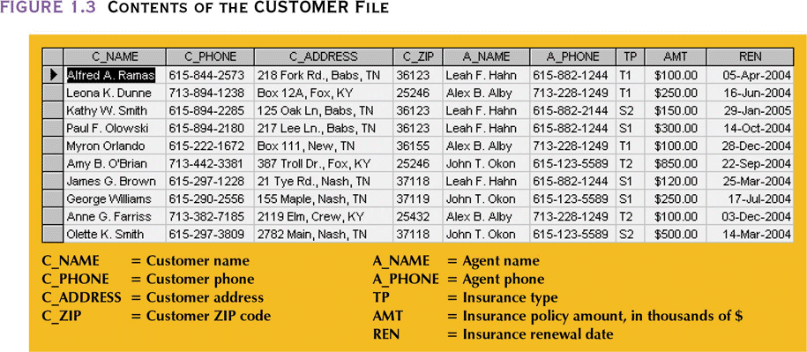
Contents of Customer File

Slide 24
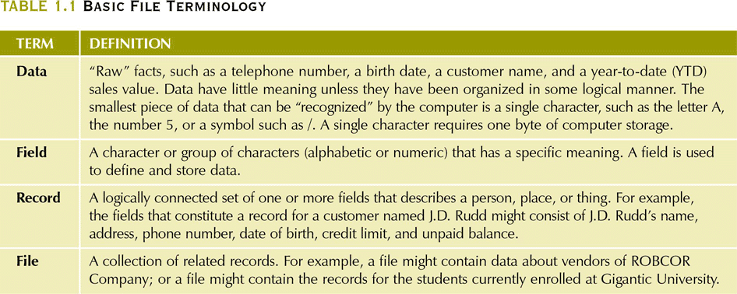
Basic File Terminology

Slide 25
Example of Early Database Design
DP specialist wrote programs for reports:
  Monthly summaries of types and amounts of insurance sold by agents
  Monthly reports about which customers should be contacted for renewal
  Reports that analyzed ratios of insurance types sold by agent
  Customer contact letters summarizing coverage
Additional reports were written as required

Slide 26
Example of Early Database Design (continued)
Other departments requested databases be written for them
  SALES database created for sales department
  AGENT database created for personnel department

Slide 27
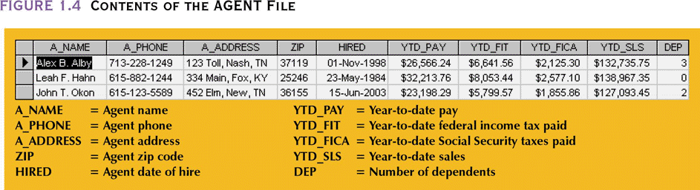
Contents of the Agent File

Slide 28
Evolution of Simple File System
As number of databases increased, small file system evolved
Each file used its own application programs
Each file was owned by individual or department who commissioned its creation

Slide 29
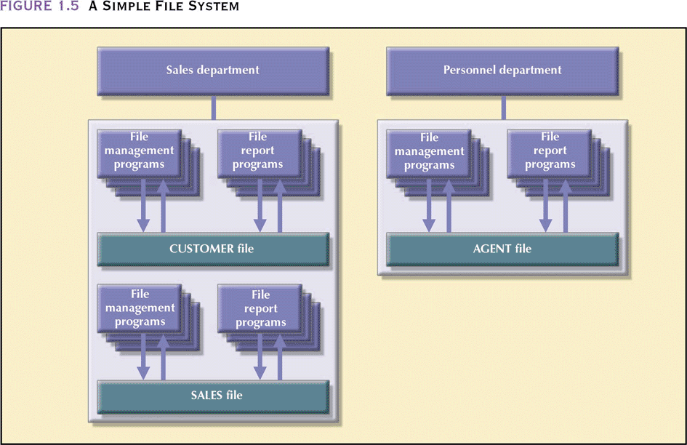
A Simple File System

Slide 30
Example of Early Database Design (continued)
As system grew, demand for DP’s programming skills grew
Additional programmers hired
DP specialist evolved into DP manager, supervising a DP department
Primary activity of department (and DP manager) remained programming

Slide 31
Problems with
File System Data Management
Every task requires extensive programming in a third-generation language (3GL)
  Programmer must specify task and how it must be done
Modern databases use fourth-generation language (4GL)
  Allows user to specify what must be done without specifying how it is to be done

Slide 32
Programming in 3GL
Time-consuming, high-level activity
Programmer must be familiar with physical file structure
As system becomes complex, access paths become difficult to manage and tend to produce malfunctions
Complex coding establishes precise location of files and system components and data characteristics

Slide 33
Programming in 3GL (continued)
Ad hoc queries are impossible
Writing programs to design new reports is time consuming
As number of files increases, system administration becomes difficult
Making changes in existing file structure is difficult
File structure changes require modifications in all programs that use data in that file

Slide 34
Programming in 3GL (continued)
Modifications are likely to produce errors, requiring additional time to “debug” the program
Security features hard to program and therefore often omitted

Slide 35
Structural and Data Dependence
Structural dependence
  Access to a file depends on its structure
Data dependence
  Changes in database structure affect program’s ability to access data
  Logical data format
    How a human being views the data
  Physical data format
    How the computer “sees” the data

Slide 36
Field Definitions and Naming Conventions
Flexible record definition anticipates reporting requirements by breaking up fields into their component parts

Slide 37
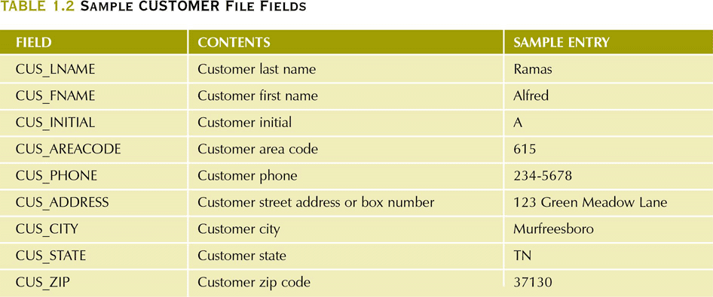
Sample Customer File Fields

Slide 38
Data Redundancy
Data redundancy results in data inconsistency
  Different and conflicting versions of the same data appear in different places
Errors more likely to occur when complex entries are made in several different files and recur frequently in one or more files
Data anomalies develop when required changes in redundant data are not made successfully

Slide 39
Data Anomalies
Modification anomalies
  Occur when changes must be made to existing records
Insertion anomalies
  Occur when entering new records
Deletion anomalies
  Occur when deleting records

Slide 40
Database vs. File System
Problems inherent in file systems make using a database system desirable
File system
  Many separate and unrelated files
Database
  Logically related data stored in a single logical data repository

Slide 41
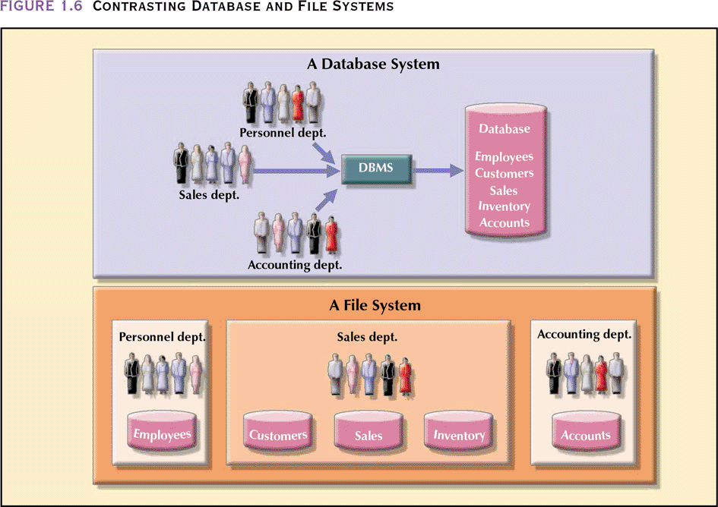
Contrasting Database and File Systems

Slide 42
The Database System Environment
Database system is composed of 5 main parts:
  Hardware
  Software
    Operating system software
    DBMS software
    Application programs and utility software
  People
  Procedures
  Data

Slide 43
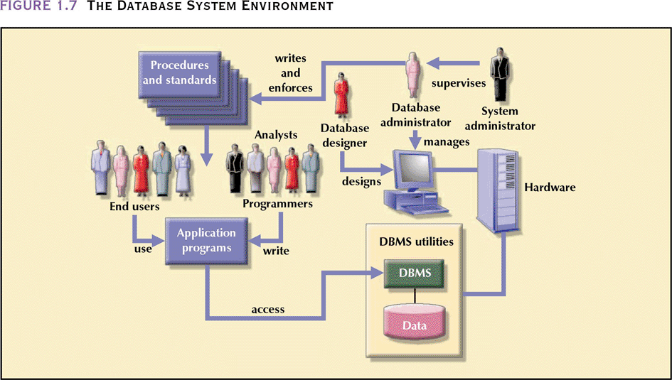
The Database System Environment (continued)

Slide 44
DBMS Functions
Performs functions that guarantee integrity and consistency of data
  Data dictionary management
    defines data elements and their relationships
  Data storage management
    stores data and related data entry forms, report definitions, etc.
  Data transformation and presentation
    translates logical requests into commands to physically locate and retrieve the requested data

Slide 45
DBMS Functions (continued)
  Security management
    enforces user security and data privacy within database
  Multi-user access control
    creates structures that allow multiple users to access the data
  Backup and recovery management
    provides backup and data recovery procedures

Slide 46
DBMS Functions (continued)
  Data integrity management
    promotes and enforces integrity rules to eliminate data integrity problems
  Database access languages and application programming interfaces
    provides data access through a query language
  Database communication interfaces
    allows database to accept end-user requests within a computer network environment

Slide 47
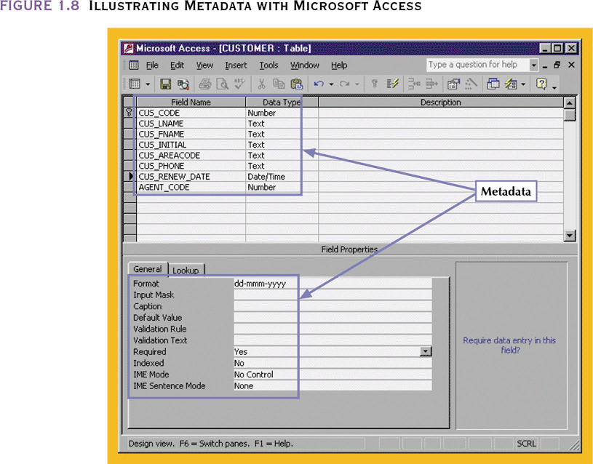
Illustrating Metadata with Microsoft Access

Slide 48
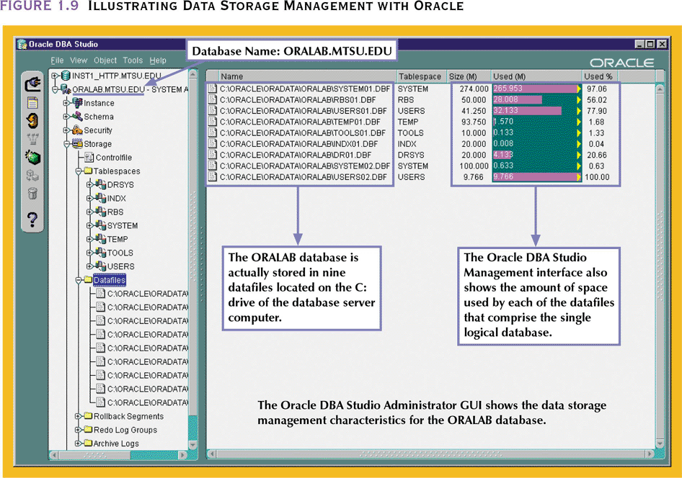
Illustrating Data Storage Management with Oracle

Slide 49
Summary
Information is derived from data, which is stored in a database
To implement and manage a database, use a DBMS
Database design defines its structure
Good design is important

Slide 50
Summary (continued)
Databases were preceded by file systems
Because file systems lack a DBMS, file management becomes difficult as a file system grows
DBMS were developed to address file systems’ inherent weaknesses

